Slide 1
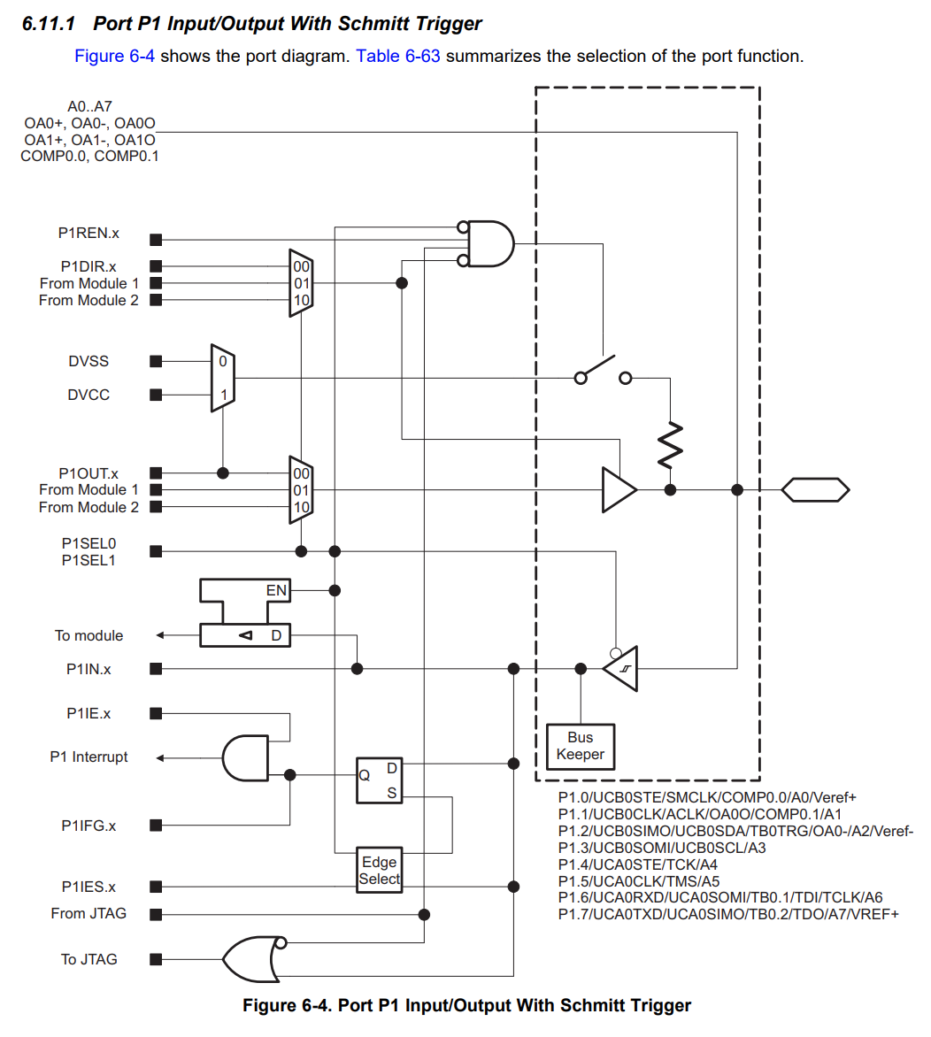
A3
P1REN.3
P1DIR.3
P1OUT.3
P1IN.3
P1IE.3
P1IFG.3
P1IES.3

Slide 2
A0
P1REN.0
P1DIR.0
1
P1OUT.0
P1IN.0
P1IE.0
P1IFG.0
P1IES.0

Slide 3
A0
P1REN.0
P1DIR.0
1
P1OUT.0
P1IN.0
P1IE.0
P1IFG.0
P1IES.0

Slide 4
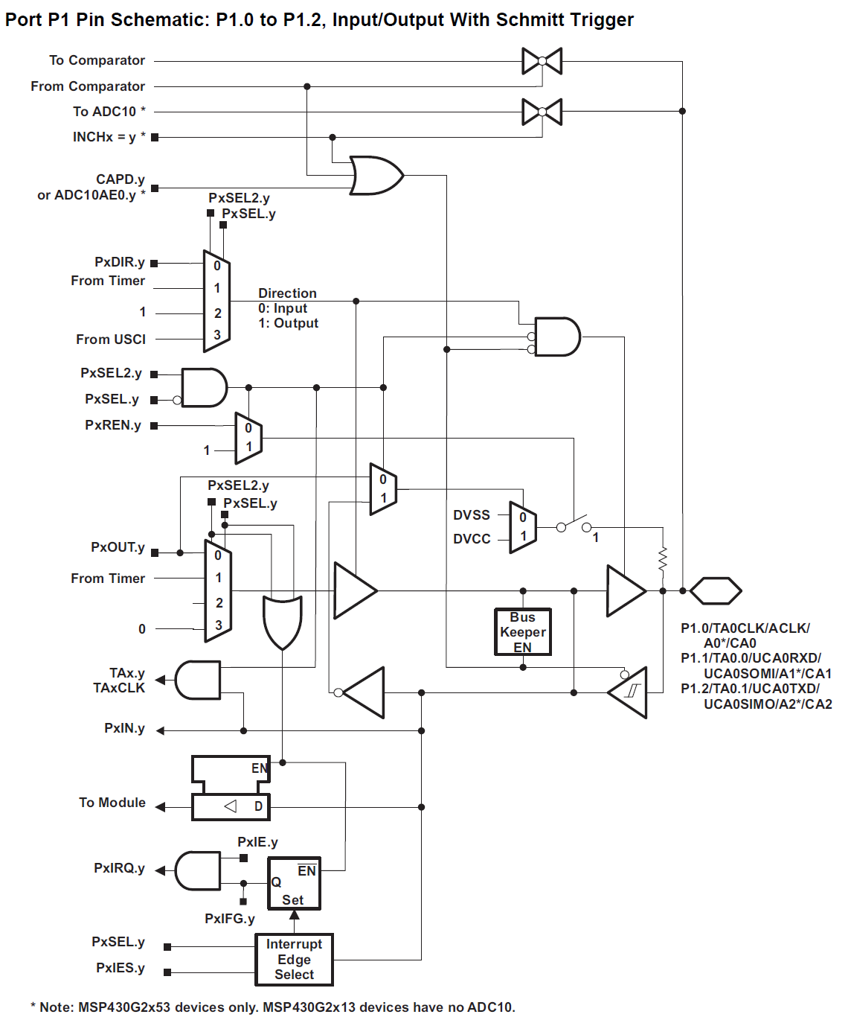
INCHx = 0*
CAPD.0
or ADC10AE.0*
P1SEL2.0
P1SEL.0
P1DIR.0
P1SEL2.0
P1SEL.0
P1REN.0
P1SEL2.0
P1SEL.0
P1OUT.0
P1IN.0
P1IE.0
P1IRQ.0
P1SEL.0
P1IFG.0
P1IES.0

Slide 5
INCHx = 0*
CAPD.0
or ADC10AE.0*
P1SEL2.0
P1SEL.0
1
P1DIR.0
P1SEL2.0
P1SEL.0
P1REN.0
P1SEL2.0
P1SEL.0
1
1
P1OUT.0
P1IN.0
P1IE.0
P1IRQ.0
P1SEL.0
P1IFG.0
P1IES.0

Slide 6
INCHx = 0*
CAPD.3
or ADC10AE.3*
P1SEL2.0
P1SEL.0
0
P1DIR.3
P1SEL2.3
P1SEL.3
1
P1REN.3
P1SEL2.0
P1SEL.0
1
1
1
P1OUT.3
1
P1IN.3
P1IE.0
P1IRQ.3
P1SEL.3
P1IFG.0
P1IES.3

